Slide 1
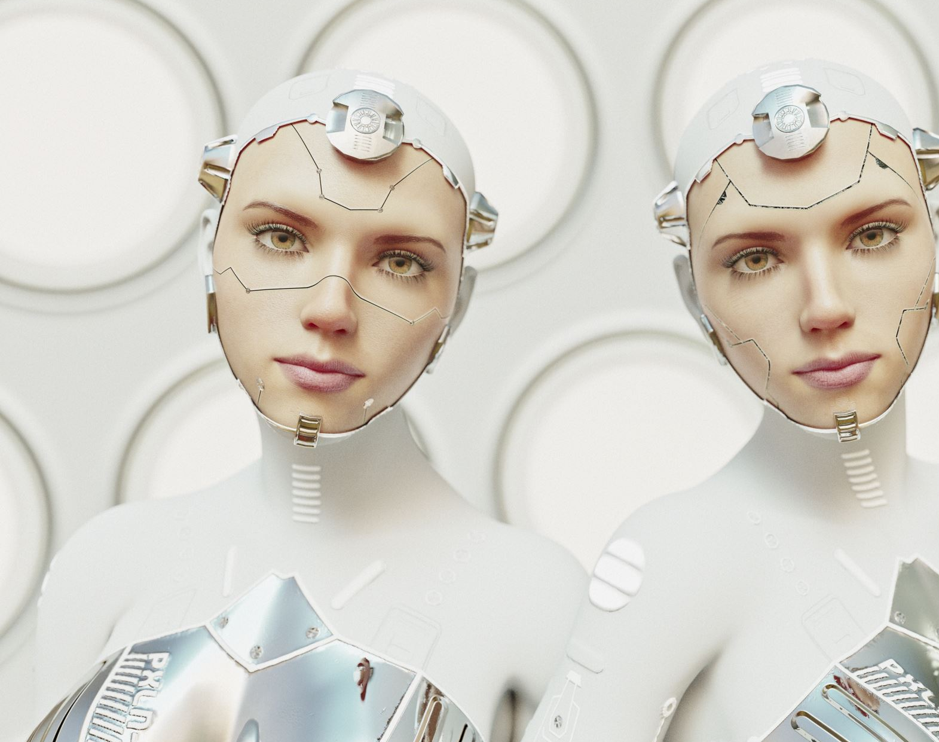
Human Image Segmentation
Team Members:
Vishnu Vardhan Koganti
Shiva Kumar Lakkampally
Sreeja Garlapati

Slide 2
Introduction:
In the realm of computer vision, one of the paramount tasks is image segmentation, a process that involves partitioning an image into distinct regions based on semantic content.
This project delves into the intricate domain of Human Image Segmentation, a task pivotal for applications ranging from object recognition to augmented reality.
The primary objective is to deploy advanced deep learning techniques to precisely delineate and isolate human subjects within images, contributing to the ever-evolving landscape of image analysis and understanding.

Slide 3
Understanding Human Image Segmentation:
Human image segmentation is a sophisticated process that transcends conventional image recognition.
Rather than merely classifying an entire image, segmentation aims to identify and delineate specific objects or regions within an image.
In the context of human subjects, this involves the intricate task of precisely outlining individuals, even amidst varying poses, backgrounds, and lighting conditions.
Achieving this level of granularity requires cutting-edge techniques that can discern fine details and capture complex spatial relationships.

Slide 4
Data Acquisition & Preparation:
Dataset Collection: We collected images that were sourced from various scenarios within the college premises, capturing different poses, lighting conditions, and backgrounds offering a contextually relevant and diverse collection .
Annotation Process: To annotate the images, we employed the Computer Vision Annotation Tool (CVAT) which facilitated manual annotation, allowing us to precisely outline humans within each image, contributing to the high-quality labels.
Custom Dataset Creation: We created a custom dataset consisting of paired images and corresponding black and white masks. The masks were generated by isolating the cutout annotated human segment, enhancing the model's ability to discern and learn human features effectively.

Slide 5
Model Selection And Tuning:
For the segmentation task, we chose the U-Net architecture with a resnet34 encoder. This architecture has proven effective for semantic segmentation tasks, particularly in capturing fine details and spatial relationships crucial for human image segmentation.
Hyperparameter Tuning:
Achieving optimal results involved a rigorous process of manual hyperparameter tuning. We systematically experimented with different configurations to enhance the model's performance. This included adjusting learning rates, batch sizes, and other parameters to fine-tune the model for our specific dataset.

Slide 6
Model Training:
During the training phase, our model exhibited promising progress, evident through decreasing loss values with each epoch. This indicated that the model effectively learned the intricate details of human segmentation within our dataset. We saved the model weights at different checkpoints to experiment with various configurations and ensure robust learning.
Custom Crop Function:
To enhance our understanding of the model's output, we implemented a custom crop function. This function allows us to visualize the model's segmentation output overlaid on the original frames. The results were visually compelling, demonstrating the model's proficiency in accurately segmenting human subjects.

Slide 7
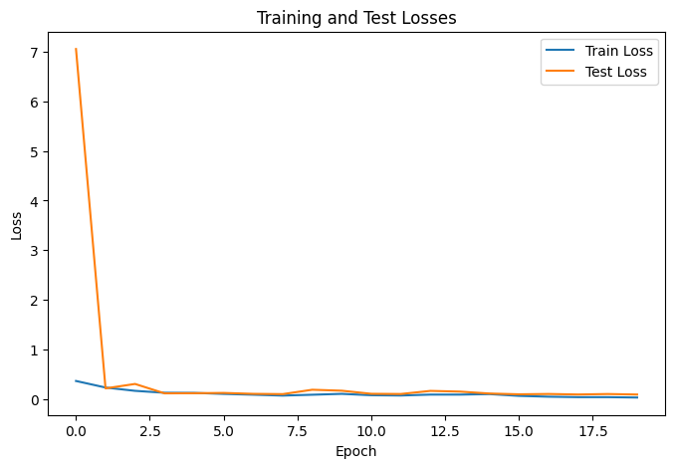
Testing and Predictions:
Using the best model weights obtained through our experimentation, we conducted predictions on test images. The model's predictions closely aligned with the ground truth masks, showcasing its ability to generalize well to unseen data.

Slide 8
Conclusion:
In summary, our data acquisition and preparation process involved the collection of images from our college, manual annotation using CVAT, and the creation of a custom dataset. The use of the U-Net model with a resnet34 encoder, coupled with meticulous hyperparameter tuning, resulted in a model that effectively learned human image segmentation. The custom crop function further aids in visualizing and interpreting the model's output, providing valuable insights into its performance.

Slide 9
Thank you!!!

